Slide 1
CS181 Project Final Presentation — Reinforcement Learning for Freeway
Wenzheng Wu∗, Panxin Tao†, Zhengtao Han‡, Runkang Yang§, Yourong Cao§
January 17, 2025
————————————————
∗ Project Leader.
† Experiments and Ablation study.
‡ Algorithm implementation.
§ Paper Writing and presentation.

Slide 2
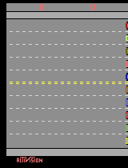
Introduction
Topic: Freeway Agent
• Based on Atari environments
• Navigate a chicken across a multi-lane highway while avoiding oncoming traffic to reach the goal at the top of the screen
• Action Space
NOOP, UP, DOWN
• Observation
Box(0, 255, (210, 160, 3), uint8)

Slide 3
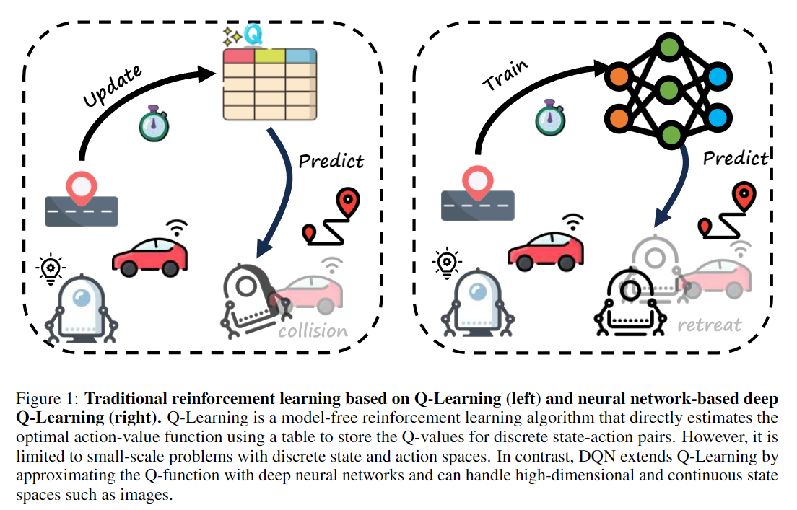
Methodology Overview

Slide 4
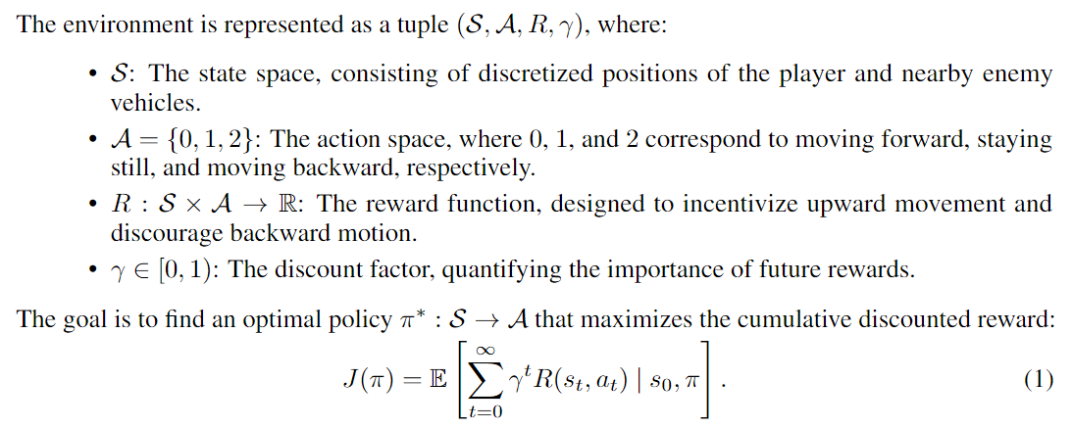
Problem Setup
• The objective is to use Q-learning, a model-free RL algorithm, to learn an optimal policy that maximizes the expected cumulative discounted reward.
• Define the problem as follows:

Slide 5
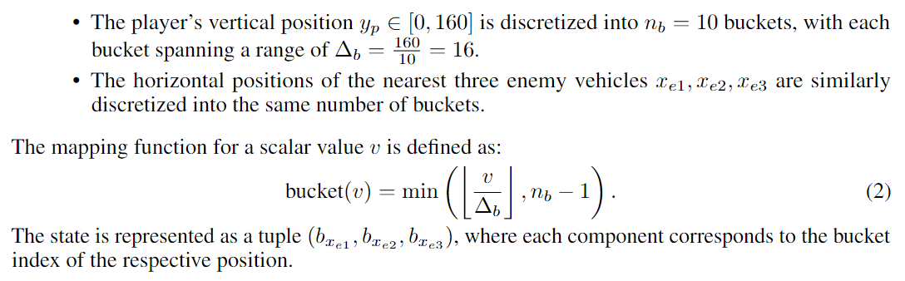
State Design
Problem:
• state can be a rgb image or a list containing ram info
• how to reduce the state dim
blocking / only considering partial info
Solution:
• map the positions into 10 blocks
• only consider the closest three cars, Q-table size are 10, 100 and 1000

Slide 6
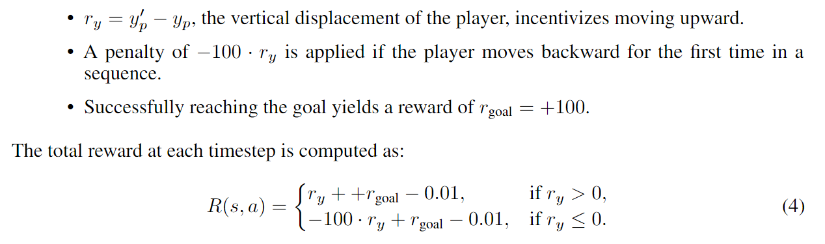
Reward Design
Positive reward:
• incentive moving upward
• reach the goal
Negative reward:
• stay in place
• moves backward
• hit by car

Slide 7
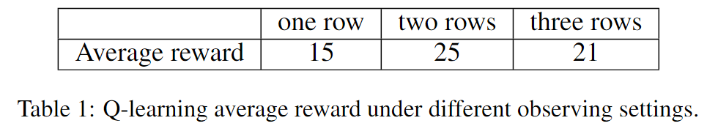
Q-Learning
Setup:
• 10 episodes, each with maximum 10,000 time steps
• learning rate 0.1
• discount factor 0.99
• exploration rate 0.1
Comparative experiments:
Observing only the vehicles in the previous row.
Observing the vehicles in the current row and the previous row.
Observing the vehicles in the current row, the previous row, and the next row.
Shortage analysis:
(i) lacks sufficient information for the player to make informed decisions, (iii) insufficient coverage of all possible states during training

Slide 8
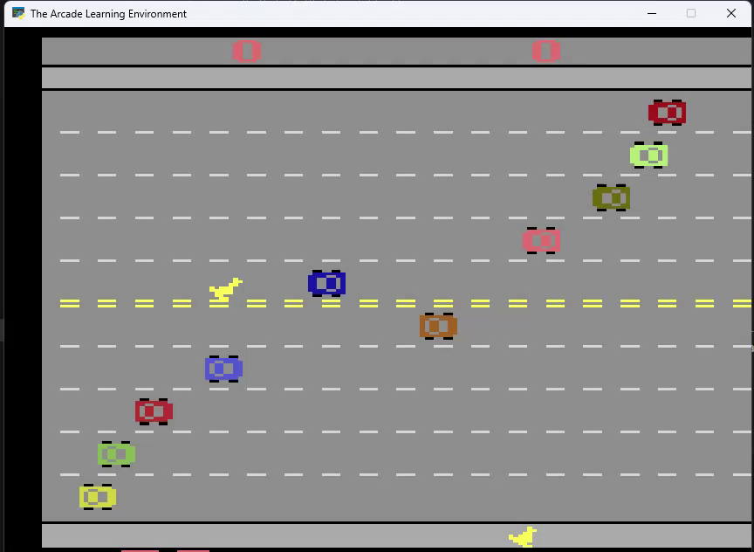

Slide 9
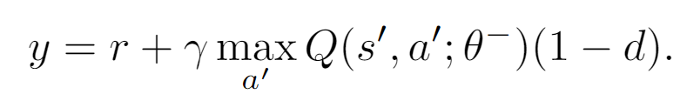
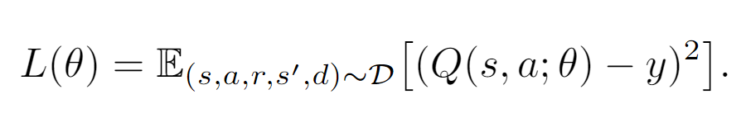
Deep Q-Learning (DQN)
Motivation:
• scalability to high-dimensional state spaces is limited by the
• reliance on discrete state-action pairs
• explicit storage of the Q-table
Experience Replay:
• a replay buffer stores transitions
• a batch of transitions is sampled from buffer during training
Target Network:
• maintain a separate target network to stabilize training
• target network is periodically synchronized with the current network
Loss Function:
• mean squared error between the predicted and the target Q-values

Slide 10
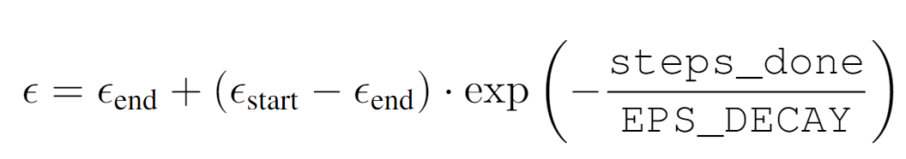
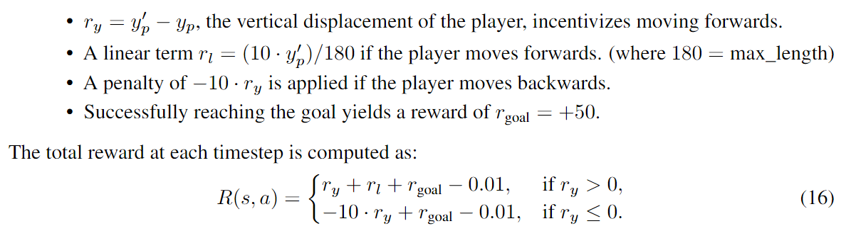
DQN with positional information
Setup:
• positional information as input
• 500 episodes, each with maximum 10,000 time steps
• learning rate 1e-4, Adam optimizer
• discount factor 0.99
• batch size 64
• epsilon decay
Reward Design:

Slide 11
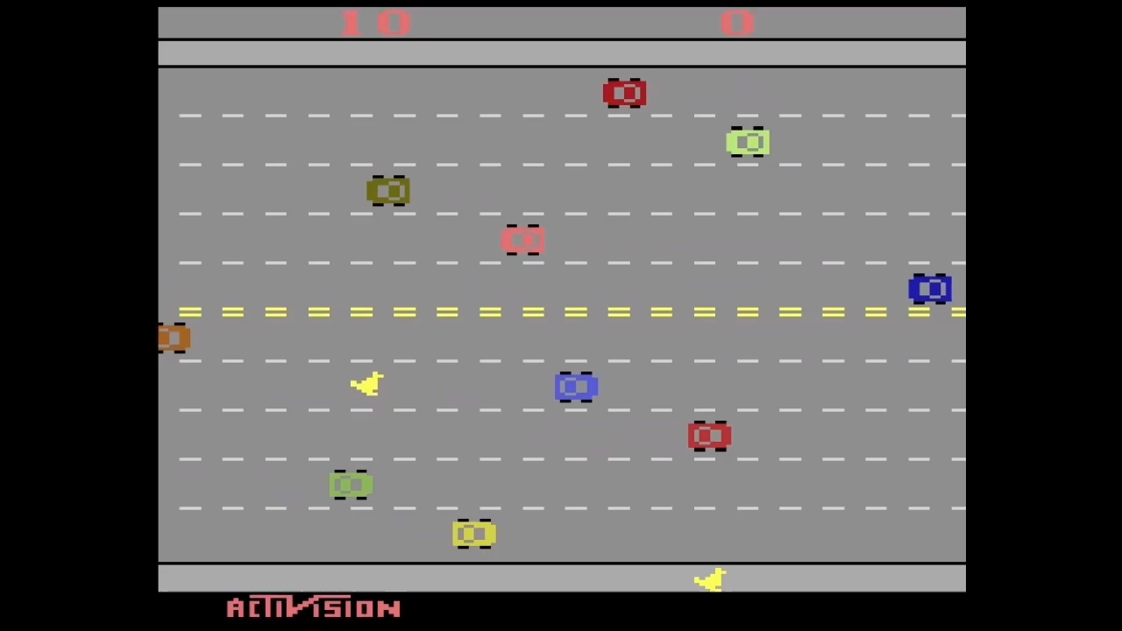
DQN with positional information

Slide 12
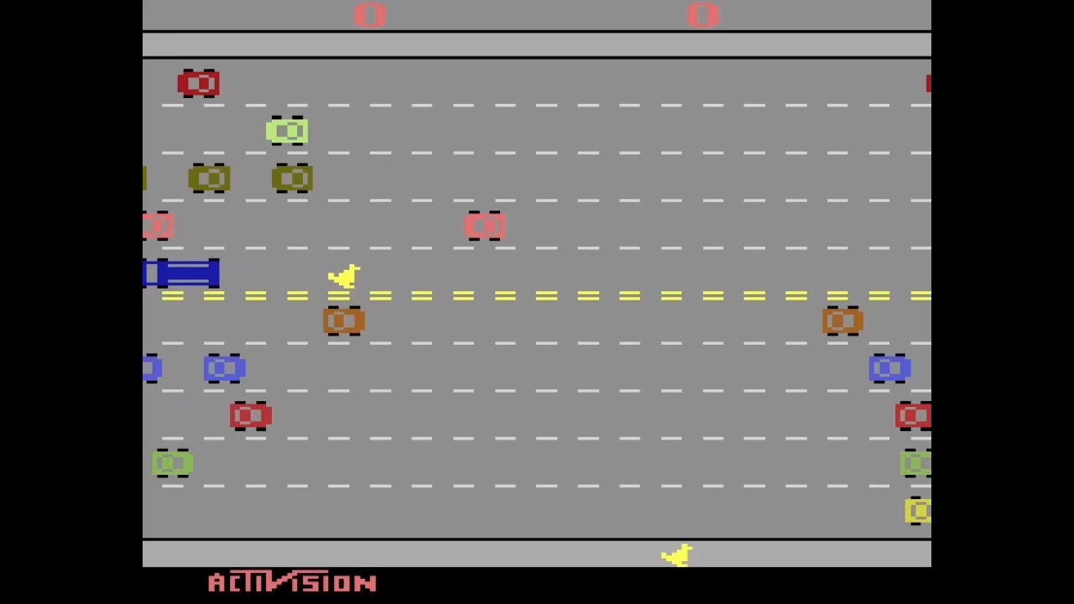
DQN with positional information

Slide 13
DQN with RGB information
Three serial stages:
• Initial Training with a Small Replay Memory
• quickly develop an initial model that could perform reasonably well
• utilize a relatively small replay buffer to allow for faster updates
• reaches an average reward of 18 after training
• Fine-Tuning with Reset Epsilon
• stabilize and refine the model
• explore rather than exploiting the insufficient experience
• average reward is improved to 22
• Enhancing Performance with Larger Replay Memory
• reduce temporal correlation of the experiences sampled for updates
• enhanced the Q-value updates and minimized the risk of overfitting
• significant increase in the average reward to 30

Slide 14
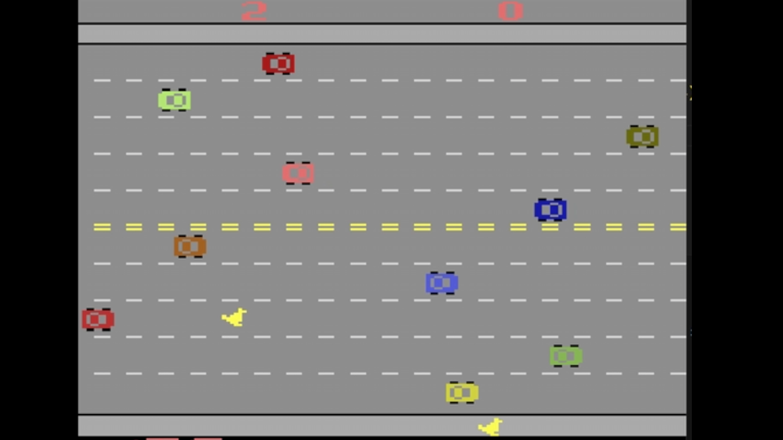
DQN with RGB information

Slide 15
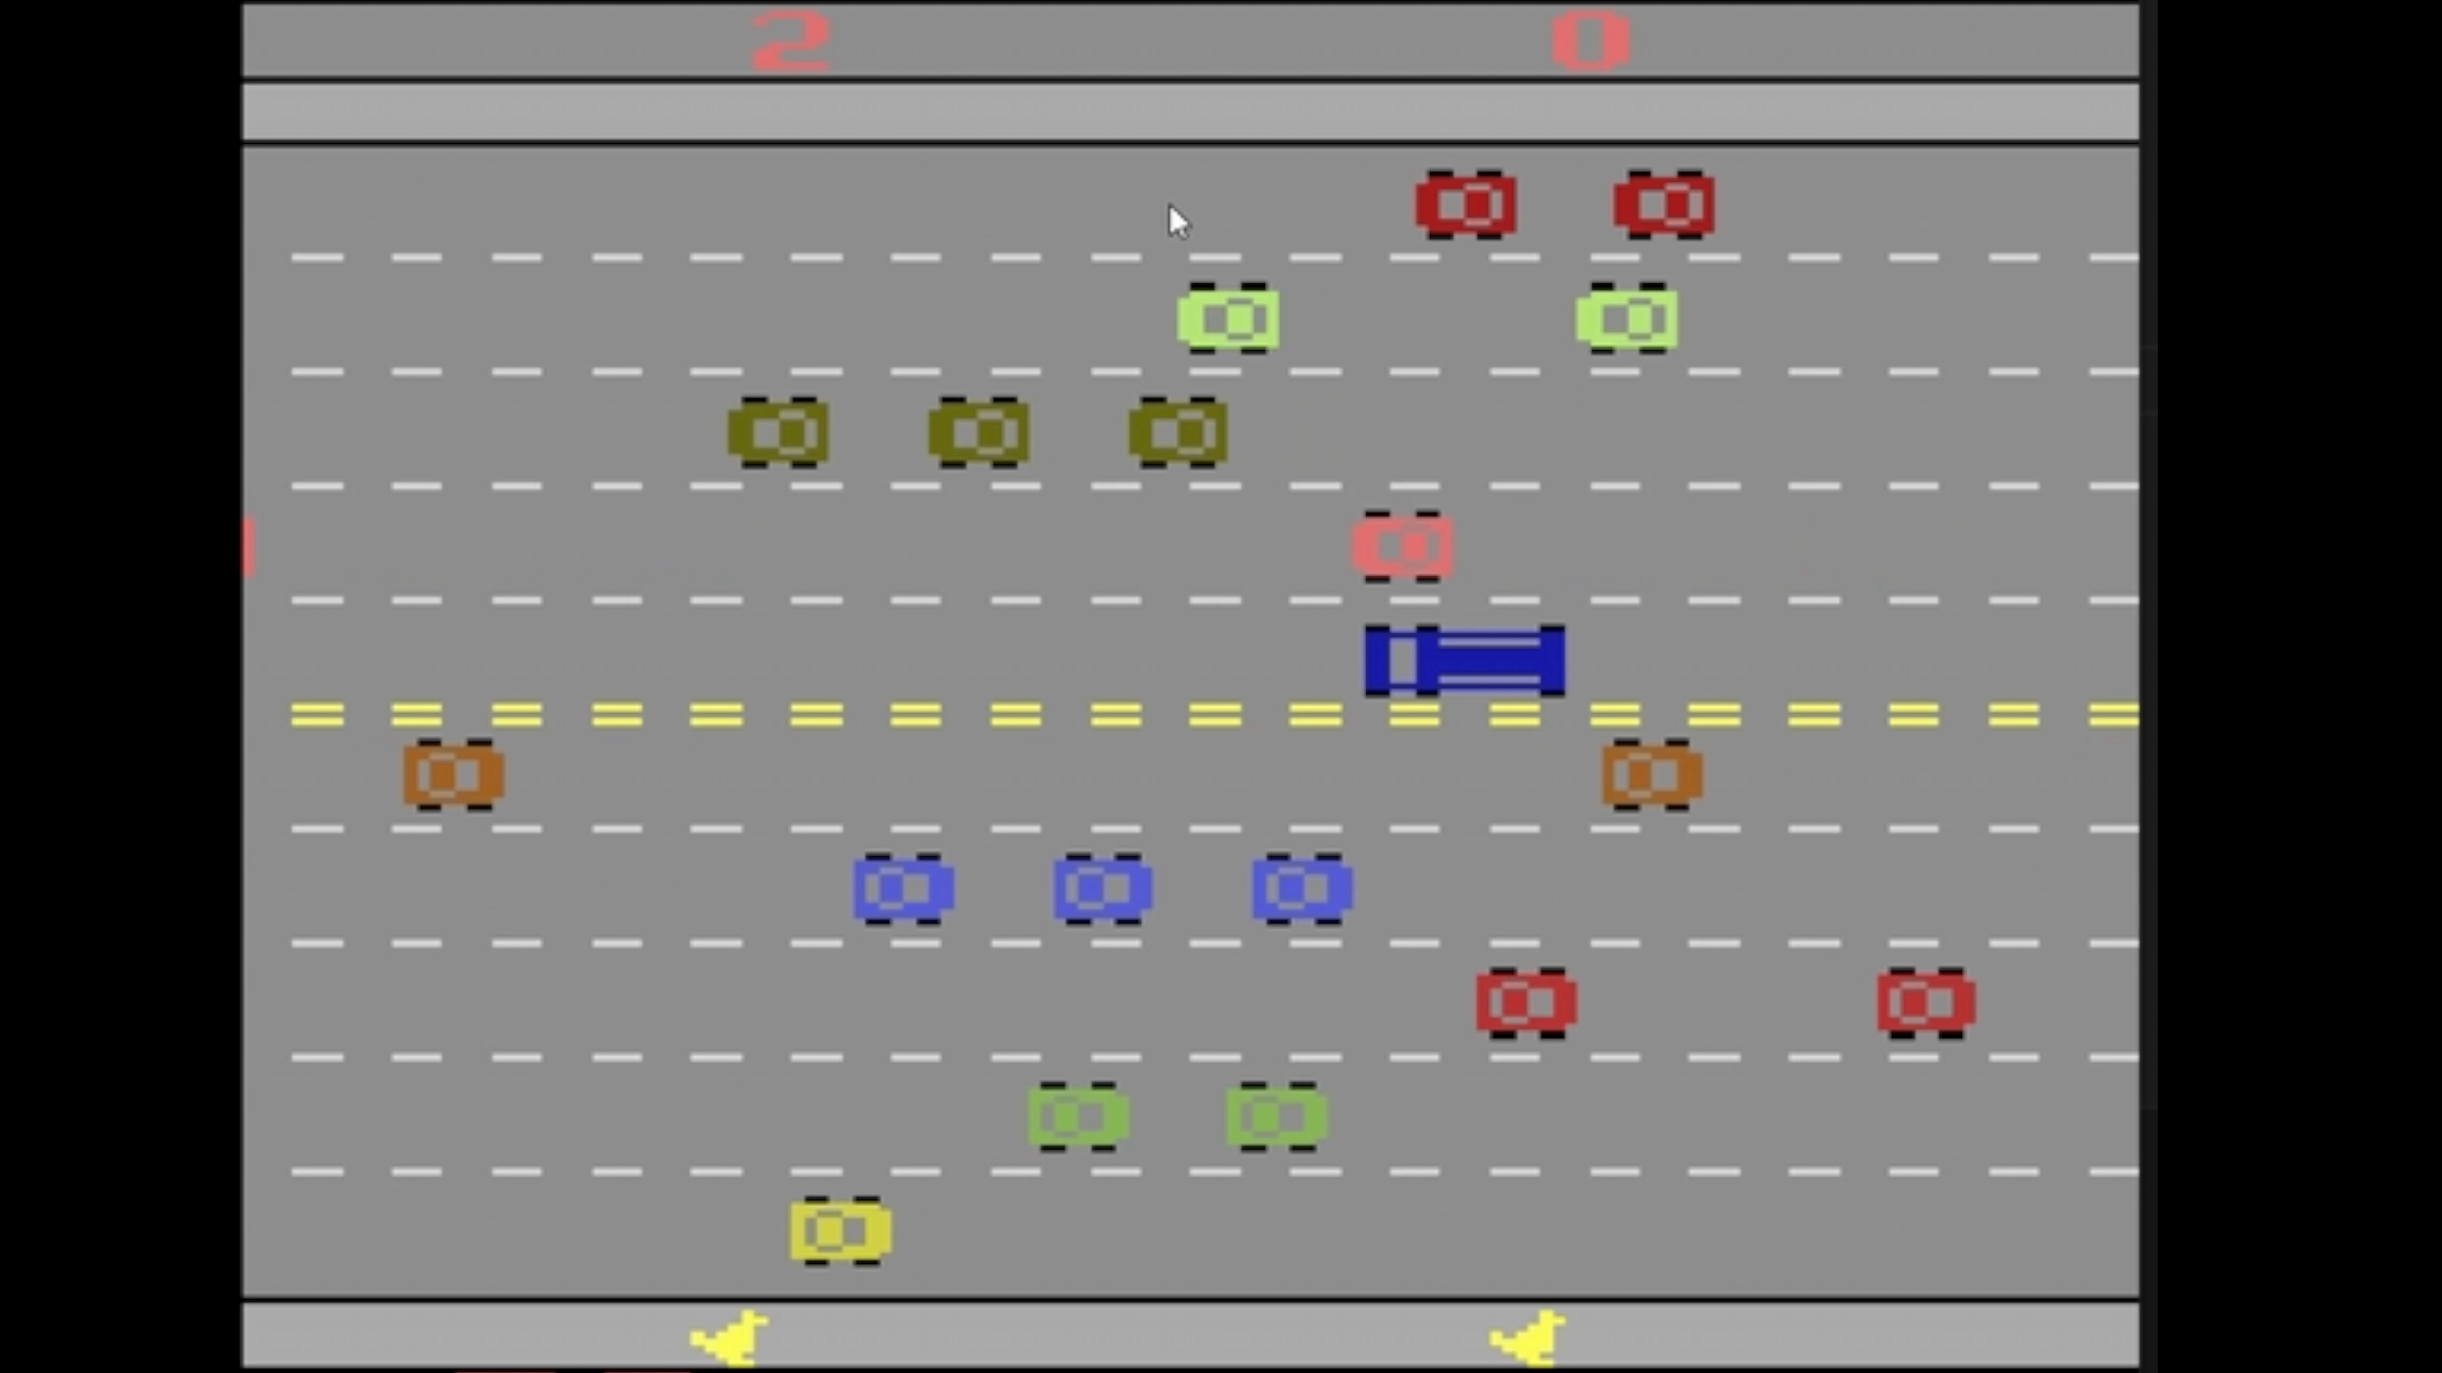
DQN with RGB information

Slide 16
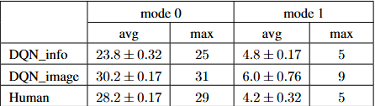
DQN reward evaluation and Human performance
DQN agent and Human performance

Slide 17
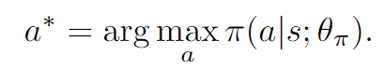
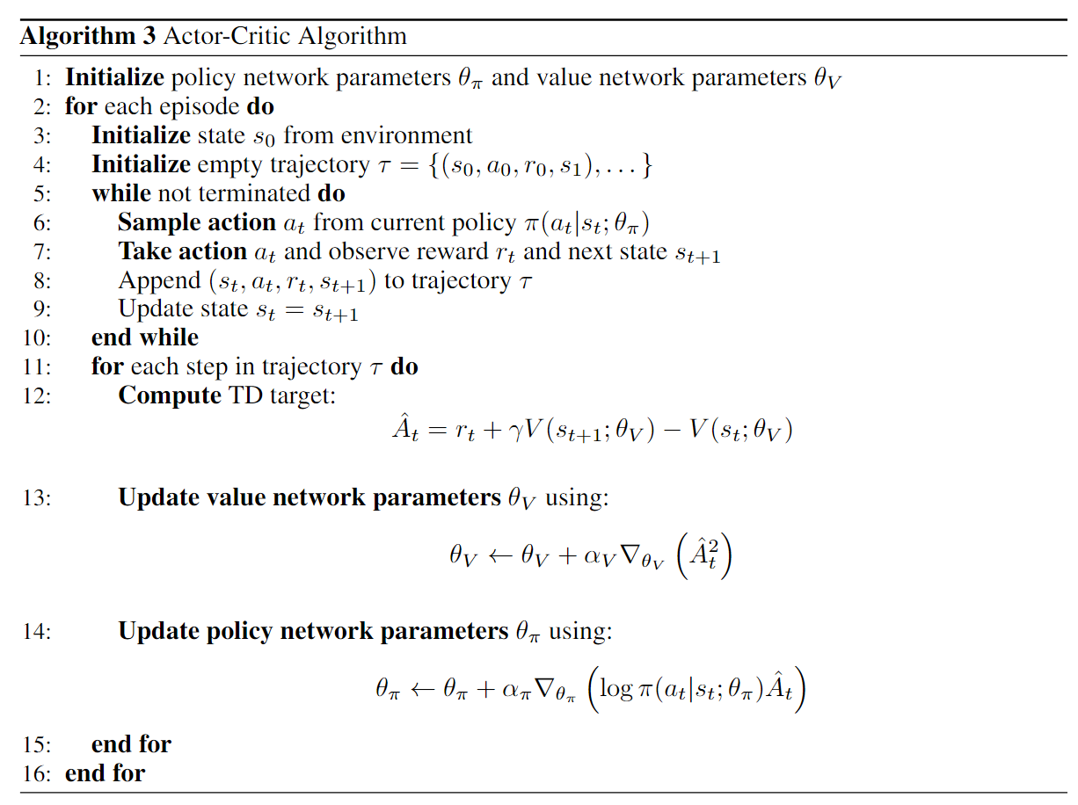
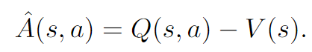
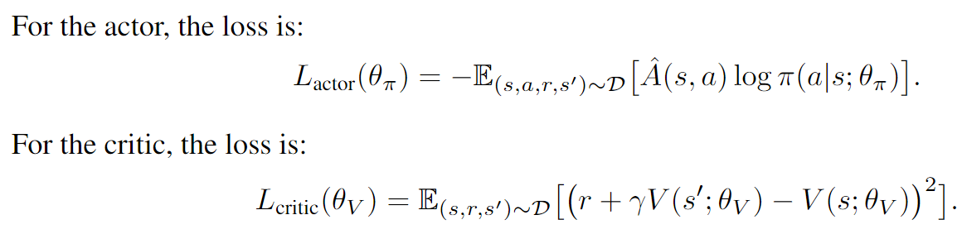
Further thinking: Actor-Critic algorithm
Motivation:
• Combining Policy Gradient and Value Function Estimation
Framework:
• the actor chooses actions
• the critic evaluates the actions
taken by the actor
• Loss function:
Algorithm:

Slide 18
External Resources
@misc{1606.01540, Author = {Greg Brockman and Vicki Cheung and Ludwig Pettersson and Jonas Schneider and John Schulman and Jie Tang and Wojciech Zaremba}, Title = {OpenAI Gym}, Year = {2016}, Eprint = {arXiv:1606.01540}, } @article{anand2019unsupervised, title={Unsupervised State Representation Learning in Atari}, author={Anand, Ankesh and Racah, Evan and Ozair, Sherjil and Bengio, Yoshua and C{\^o}t{\&apos;e}, Marc-Alexandre and Hjelm, R Devon}, journal={arXiv preprint arXiv:1906.08226}, year={2019} }

Slide 19
Thanks !

